Slide 1
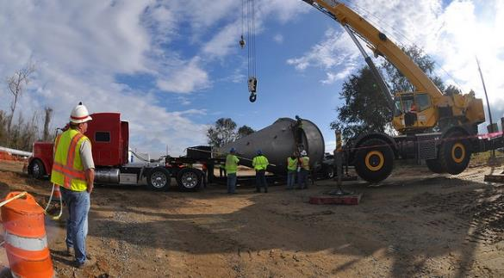
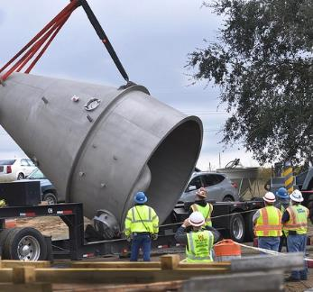
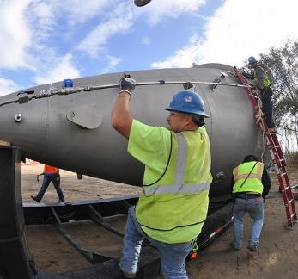
Information security & acquisitions
Mr. David Curry
Chief, Strategic Integration
Directorate of Contracting
U.S. Army Corps of Engineers
31 March 2025

Slide 2

AGENDA
  Background
  CUI - Controlled Unclassified Information
  NIST - National Institute of Standards and Technology scores
  CMMC - Cybersecurity Maturity Model Certification
  Questions/Discussion

Slide 3
PROBLEM STATEMENT
DoD and the Defense Industrial Base (DIB) face increased security risks due to slow / no compliance with DoD mandates related to Controlled Unclassified Information (CUI).

Slide 4
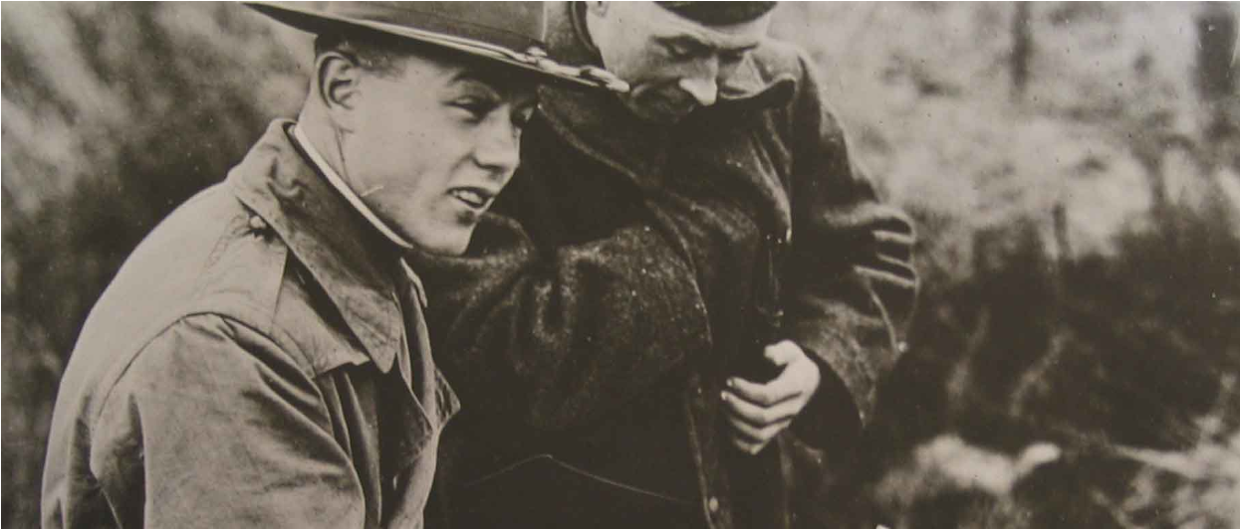

BACKGROUND
BUILDING STRONG®

Slide 5
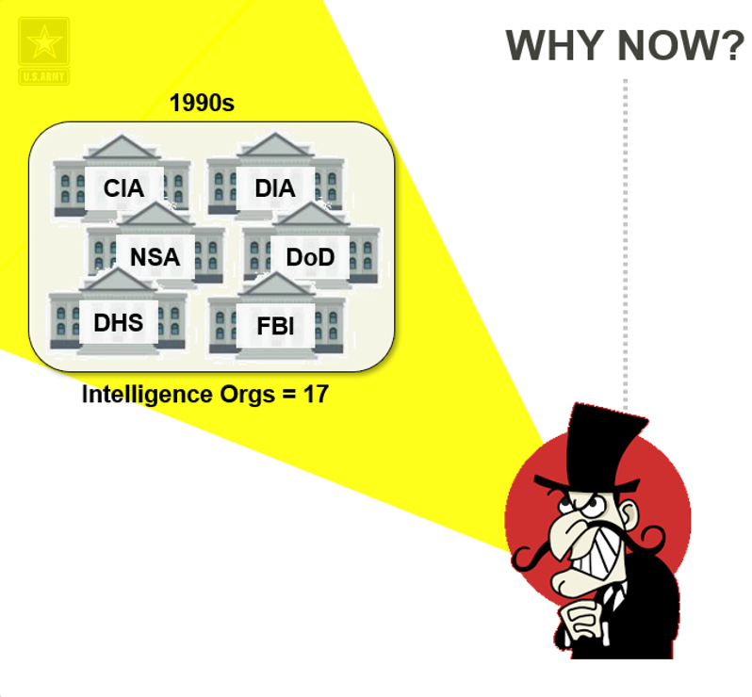
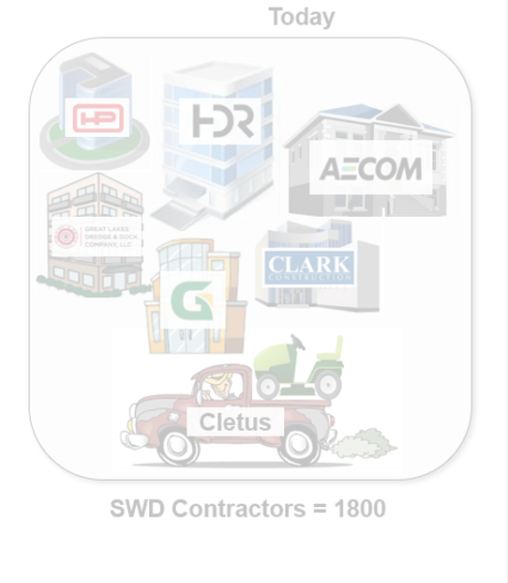
Our enemies used to target the US intelligence agencies
Notes:
KEY POINT:
ROI for the bad guys wasn’t worth it

Slide 6
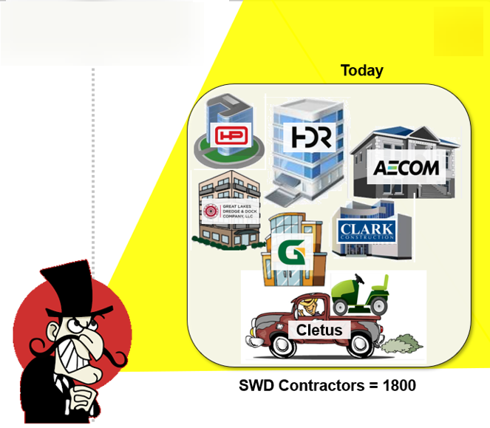
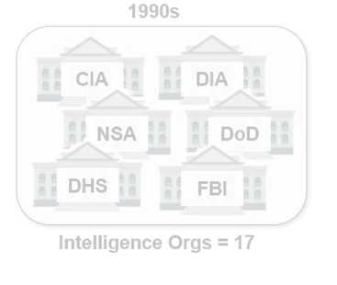
Why now
WHY NOW?
They soon realized a MUCH easier target is the Defense Industrial Base.
Notes:
KEY POINT:
Bad guys shifted focus to Defense Industrial Base (DIB)
DIB is nowhere close to security of the 17 intelligence agencies

Slide 7
History of INFOSEC/ CYbersecurity
27 MAY 09 – POTUS memo calling for examination of CUI and Interagency Task Force
04 NOV 10 – POTUS issues Executive Order 13556 – Controlled Unclassified Information (CUI)
18 NOV 13 – Final rule passed, NIST SP 800-53, Unclassified Controlled Technical Information
01 AUG 15 – DoD publishes DFARS Clause 252.204-7012 - Safeguarding Unclassified CTI
26 AUG 15 – Interim rule passed, NIST SP 800-171, Covered Defense Information
30 DEC 15 – Interim rule passes, NIST SP 800-171, Operationally Critical Support
14 SEP 16 – 32 CFR Part 2002 introduces the first legal framework for CUI
21 OCT 16 – Final rule passed, NIST SP 800-171
30 OCT 16 – DFARS 252.204-7012 goes into effect
15 NOV 18 – DoD Memo on implementing CUI
06 MAR 20 – DoD Instruction 5200.48 Established DoD CUI Policy
30 NOV 20 – DFARS interim rule goes into effect requiring NIST score in SPRS to receive awards
04 DEC 20 – Director of National Intelligence requests POTUS kill CUI and EO 13556
31 DEC 20 – Deadline for agencies to issue CUI implementation guidance
01 OCT 25 – CMMC goes into full effect, no award without CMMC certification
15yr
onramp
Notes:
KEY POINT:
None of this INFOSEC stuff is new
For once, DoD gave us all a VERY long on-ramp, so no excuses
DoD is late to the game, so need to act NOW!

Slide 8
WHERE ARE WE TODAY?
CUI mandated 10+ years ago, in DoD contracts since 2017
Still widespread variance in DoD implementation of CUI
Ex: USACE has no one person identified as CUI owner
DIB feedback? DoD marks too little info as CUI…or too much
    Too little = security risk, exposes sensitive information to our enemies
    Too much = cost risk, DIB charges us and protecting CUI is expensive
Spotty DIB understanding of CUI and clause requirements
Ex: few if any in the DIB comply with Cyber Crimes mandate
Ex: most USACE solicitations are currently silent on CUI
Two forcing functions will drive DoD/Army/USACE action:
1) Cybersecurity Maturity Model Certification (CMMC)
2) Completion of the CUI rule-making process

Slide 9
CUI
BUILDING STRONG®

Slide 10
WHAT IS CUI ?
Controlled Unclassified Information (CUI) is sensitive info that doesn’t quite rise to the level of classification…but still warrants protection. It is UNCLASSIFIED information that requires identification, marking, safeguarding and dissemination controls required by law, regs and policy. Note, CUI may be created by the Government or DIB contractors.

Slide 11
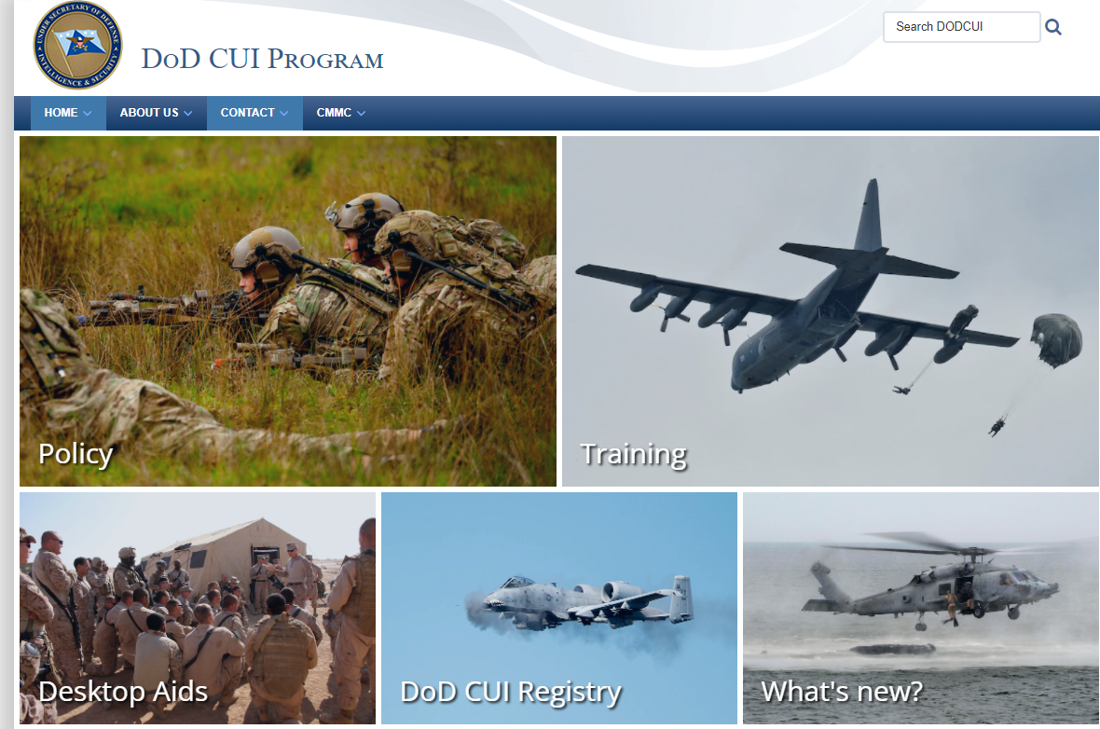
.dodcui.
www mil
Notes:
KEY POINT:
These DoD sites are usually horrible, this one is GREAT
ALL the necessary info is there, text, tools, videos, etc. USE it

Slide 12
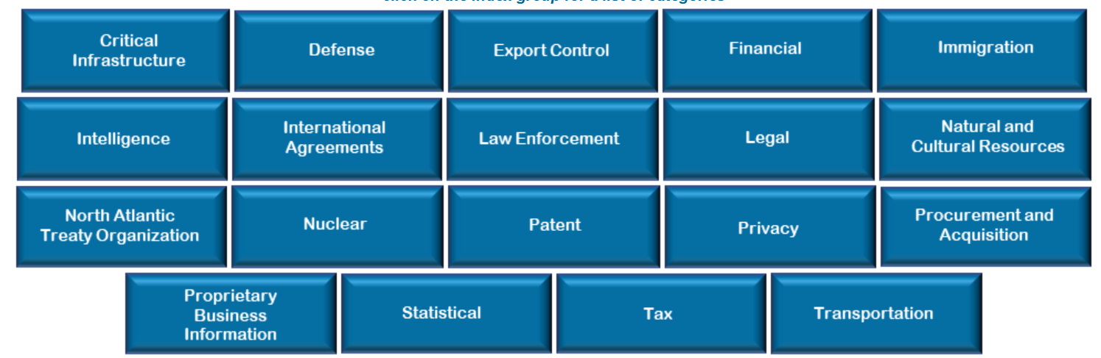
DOD INDEX GROUPS*
112 “Categories” of CUI across 18 “Index Group”
Defense
*Note: NARA owns CUI, and lists more categories and groups, but DoD has fewer.
Notes:
KEY POINT:
Categories are easy to access and understand.
The hard part is the time it takes to decide what is /is not CUI

Slide 13
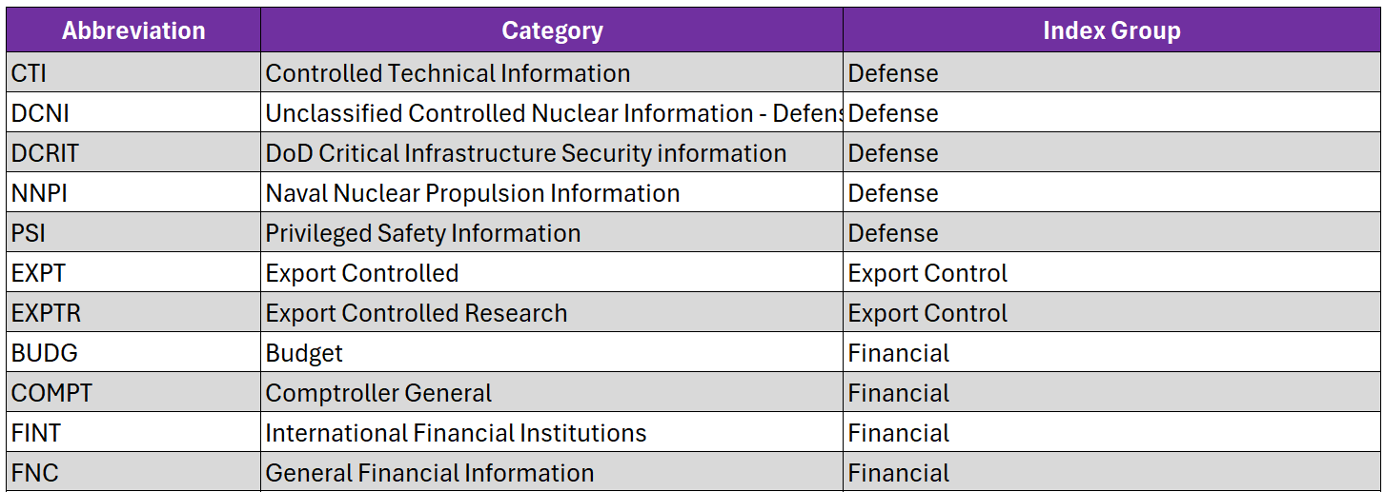
DOD CUI REGISTRY
112 “Categories” of CUI across 18 “Index Group”

Slide 14
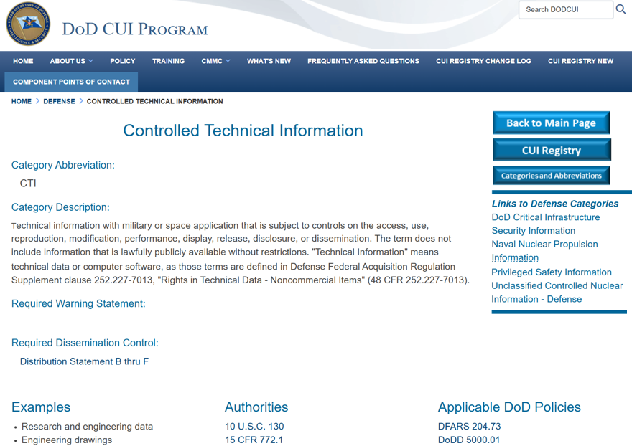
DOD CUI REGISTRY
Notes:
KEY POINT:
The deep dive pages provide great info about CUI details.
For example, it tells you how to fill out the 5 line block on the front of all CUI, such as the Limited Dissemination Controls statement

Slide 15
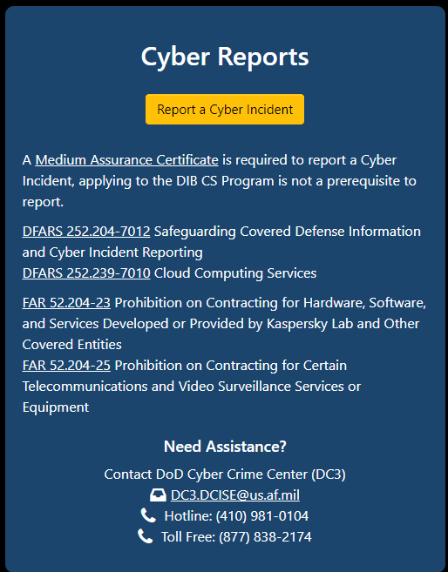
CUI BASICS
  SHARED responsibility of Government (GOV) and Contractor (DIB) personnel
  GOV responsibilities:
    Identification
    Communication
    Marking
    Safeguarding
  DIB responsibilities:
    Marking
    Safeguarding
    Reporting – 100%, even suspected cyber incidents to DoD.
  DoD Cyber Crime Center = central node to report incidents: https://dibnet.dod.mil
  Can also report anomalous cyber activity 24/7 to: report@cisa.gov or (888) 282-0870
Notes:
KEY POINT:
Nothing happens if we don’t IDENTIFY our CUI
We aren’t, but we’re paying the DIB anyway, waste of money
Only option is to comply, come up with a PLAN and execute

Slide 16
CUI sounds resource intensive!
YES.
Notes:
KEY POINT:
Commanders need to know the size of the problem
Only then can we budget/plan/resource the fix

Slide 17
RECENT EXAMPLES
Ex #1: 2023 Industry Day ~ 500ish companies attending
  Conducted real time poll:
  KTRs with a cyber breach / suspected breach in the last 12mos? 475
  How many companies reported incident to DoD? 0
Ex #2: 2024 Industry Day ~ 500ish companies attending
  Conducted real time poll:
  KTRs with a cyber breach / suspected breach in the last 12mos? 486
  How many companies reported incident to DoD? 0
One WOSB reported she was fully prepped for CUI/CMMC.
When asked why? “Because I plan to win” – sees it as competitive advantage
Notes:
KEY POINT:
Lack of compliance and reporting to DoD is widespread
No improvement after a year of focus, Industry Days
This is HUGE culture change, for us and DIB
Requires an intentional PROACTIVE plan to implement change

Slide 18

…the CUI ASK
Designate at least 1 person to own CUI
Educate org on CUI, what / when / why / how
Educate industry on what we’re paying them to do
Study the JAN 2025 Federal Register post on CUI
Mark and safeguard CUI IAW with regs / statute
Establish checks / balances to ensure compliance

Slide 19
NIST SCORES
BUILDING STRONG®

Slide 20
WHAT IS THE NIST REQUIREMENT?
Rolled out in 2017/2018 timeframe
NIST SP 800-171 Rev2, “Protecting CUI in Nonfederal Systems
and Organizations Security Requirements”
DoD’s 110 item Microsoft Excel checklist
KTRs must annually self-assess their cyber hygiene
KTRs upload their score into PIEE/SPRS
KOs validate a NIST score is present before award
KOs download a copy and store it in PCF.
Scores don’t matter, only that KTR performed the assessment
NIST is a statutory mandate not a policy initiative
No NIST score = No Award

Slide 21
If a contractor numeric NIST score doesn’t currently matter, then what’s the point?

Slide 22

PRACTICE. PRACTICE. REPEAT.
The point of NIST scores is muscle memory.
DoD’s goal: think about cyber hygiene 1x/year
    Pay attention to security.
    Assess your hygiene.
    Fill your gaps.
    Report your status.
    Repeat.
Just like taxes.
Just
Like
this

Slide 23
…the NIST ASK
Prioritize and support organizational NIST compliance
Educate your organization on NIST requirements
Ensure NIST compliance across your portfolio
Don’t settle for the minimum, meet the intent of NIST
Implement plan for cyber hygiene before 1 OCT 25

Slide 24
CMMC
BUILDING STRONG®

Slide 25
WHAT IS CMMC ?
The Cybersecurity Maturity Model Certification (CMMC) is a new DoD standard to ensure security of Federal Contract Information (FCI) and CUI within the Defense Industrial Base (DIB). Starting 1 OCT 25, certification is mandatory for all DIB contractors.

Slide 26
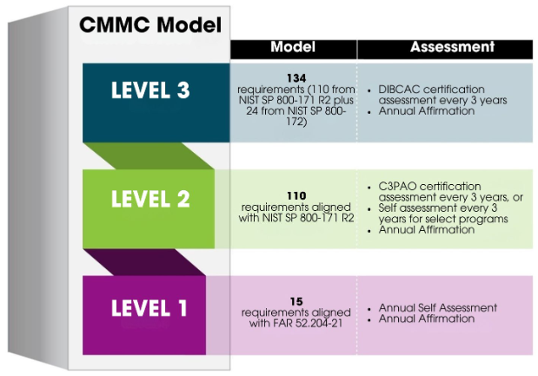
CMMC BASICS
134
LOW
FY28
Requirements (110 from NIST SP 800-171 R2 plus 24 from NIST SP 800-172)
- DIBCAC certification
assessment @ 3yrs
- Annual Affirmation
110
- C3PAO cert. @ 3yrs, or
- Self-assessment every
3yrs for select programs
- Annual Affirmation
FY27
Requirements aligned
with NIST SP 800-171 R2
17
FY26
Requirements aligned
with FAR 52.204.21
Annual Self-Assessment
Annual Affirmation
Notes:
KEY POINT:
DoD did agree to soften the blow
DoD did NOT change the DATE
Waivers will be allowed by the HCA, should be rare
No need for FY26 waivers as all info is Level 1

Slide 27
Phased CMMC Implementation
FY26
FY27
FY28
1 OCT 25
Level 1 – Self-certification [no CUI]
1 OCT 26
Level 2s – Self-certification [CUI in play]
(POA&Ms)
1 OCT 26
Level 2c – C3PAO
(POA&Ms)
1 OCT 27
Level 3c – DIBCAC
(POA&Ms)
Plans of Action and Milestones (POA&Ms)
Notes:
KEY POINT:
Beginning in FY27, Level 1 only if there is no CUI in play
As soon as CUI is present, automatically kicks to Level 2
Level 2 really has 2 levels depending on Index group of CUI
Certification gets exponentially more expensive up to Level 3

Slide 28
…the CMMC ASK
Prioritize and support CMMC compliance
Educate your organization on CMMC requirements
Put in plan to achieve CMMC Level 1 by 1 OCT 25
Recommend CMMC backcheck metrics, measure progress/risk
Actively engage with PTACs for Small Business partners
Cover CMMC in Customer/Partner/Trade Org meetings

Slide 29
IMPLEMENTATION
BUILDING STRONG®

Slide 30
IMPLEMENTATION LINES OF EFFORT
Form CMMC Task Force [CT]
HQ OPORD for Commanders [CT]
DIB training [CT]
Standardize procedures [CT/EC]
USACE training [CT]
Implement oversight [CT]
Audit of existing:
      CUI [ALL]
      Audit existing infrastructure [OPS]
      Audit existing IT ecosystem [G6]
Notes:
KEY POINT:
Most important step for USACE is OPORD and Program Manager
Next is over-communicating with the limited time left.

Slide 31



Slide 32
Key terms
AI = Artificial Intelligence
AO = Affirming Official
CamoGPT = Army’s secure CAC-enabled AI tool
ChatGPT = Leading online AI tool
CMMC = Cybersecurity Maturity Model Certification
CTI = Controlled Technical Information (a subset of CUI)
CUI = Controlled Unclassified Information
FOUO = For Official Use Only
NIST = National Institute of Standards and Technology
OAS = Organization Seeking Assessment
PIEE = Procurement Integrated Enterprise Environment
SPRS = Supplier Performance Risk System

Slide 33
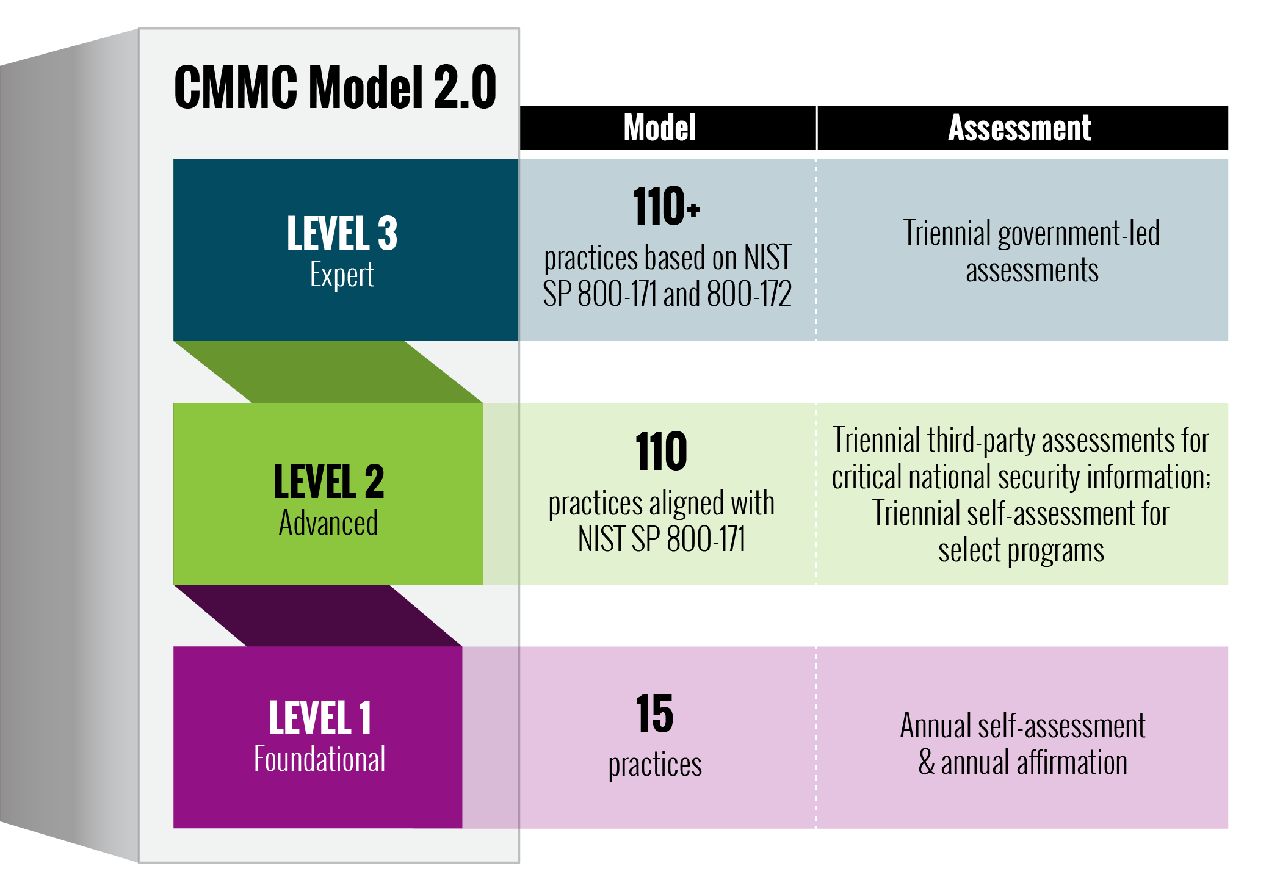
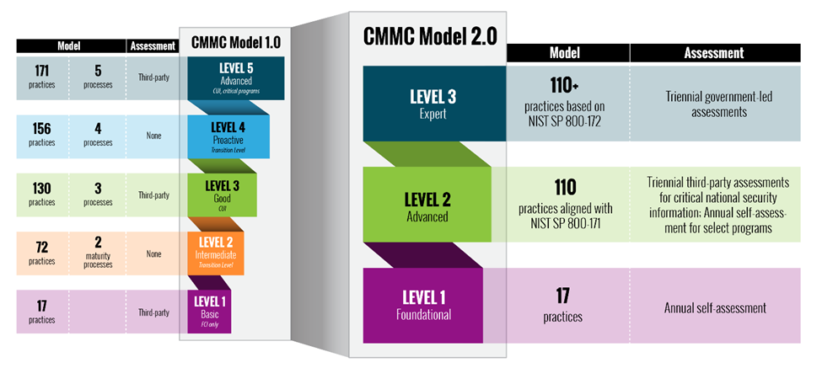
ORIGINAL CMMC FRAMEWORK
LOW

Slide 34
CURRENT CMMC FRAMEWORK
LOW
Notes:
KEY POINT:
DoD did agree to soften the blow
DoD did NOT change the DATE and still NO waiver/exception

Slide 35
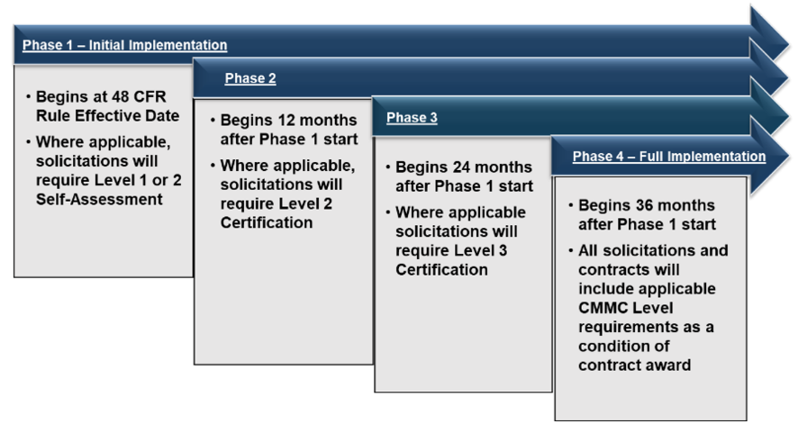
Phased CMMC Implementation

Slide 36
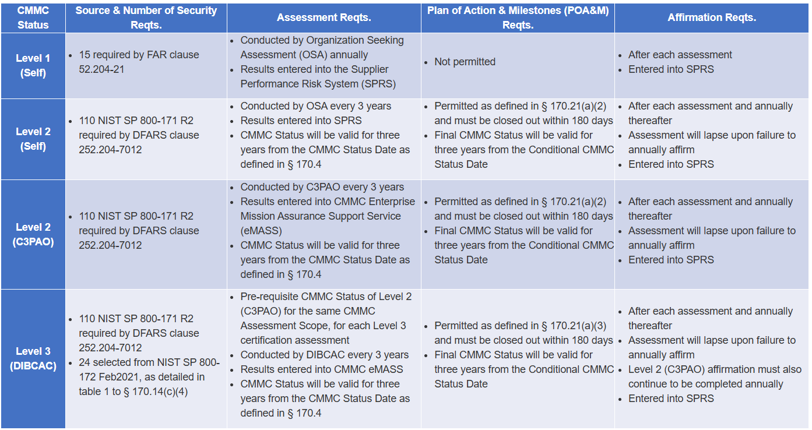
Phased CMMC Implementation

Slide 37
IMMEDIATE (1 Month)
Brief Executive Sponsors
Recruit team members and finalize charter
Develop and issue OPORD
Initiate and issue recurring SAM.gov announcement from HQ
Develop plug/fill SAM.gov template for use by Districts/Centers
Webinars: SCOs, RBDs, RPDs, BoBs, KOs
Develop CMMC flowchart for UAI
Develop USACE webinar deck
Develop DIB webinar deck
Develop Steering Committee IPR template
HCA email to CT CoP with WARNO and status update
Conduct IPR #1 with Steering Committee

Slide 38
NEAR TERM (2 Month)
Baseline readiness survey w/ key stakeholder groups
Webinar: E&C Chiefs
Webinar: Civilian Deputies (DPMs)
Develop UAI section for CUI
Develop UAI section for CMMC
Update UAI checklists to incorporate CUI and CMMC
List of active DIB contractors, by USACE org, to CoCOs/DPMs
CMMC PgM email to CT CoP with status update and DIB list
HCA email to CT CoP reinforcing OPORD, roles & responsibilities
Conduct IPR #2 with Steering Committee

Slide 39
Short TERM (3 Month)
Incorporate final SF XXX into the UAI
Issue FRAGO to incorporate SF XXX into HQ guidance
Brief USACE governance forums: DR-C, BR-C, and ER-C
Conduct IPR #3 with Steering Committee
Capture metrics, report status and compliance in monthly IPRs
Monitor progress across Districts/Divisions; adjust as needed
Conduct monthly IPRs with Steering Committee
MEDIUM TERM (6 Month)

Slide 40
Long TERM (FY26 – FY28)
Develop/field INFOSEC PROSPECT course
Monthly CT data calls, by org, for non-responsive DIB eliminations
Monthly BI audit of awards to validate CMMC Level 1 compliance
Monthly cycle time audit for CMMC waiver requests to HCA
Monthly report to Director on metrics and compliance
Bi-annual IPRs with Steering Committee

Slide 41
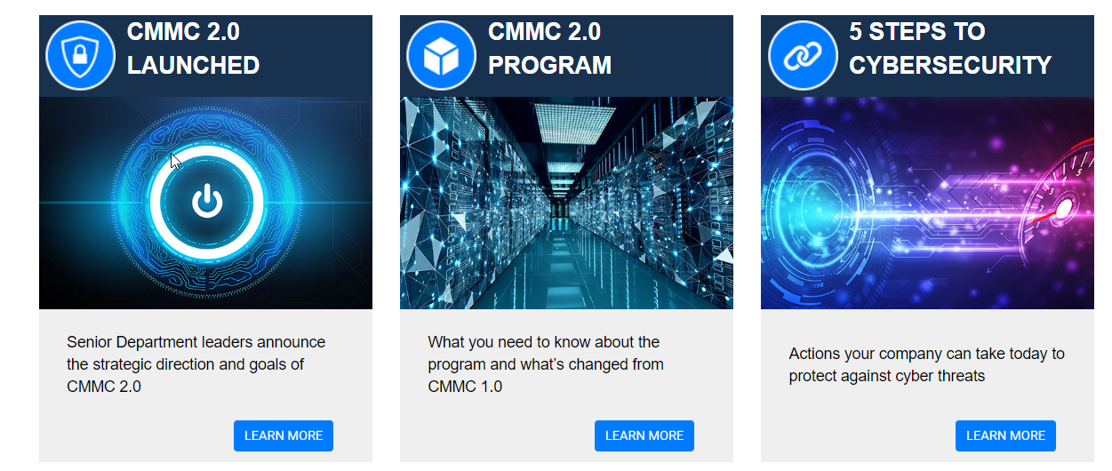
https://dodcio.defense.gov/CMMC/
LOW

